Slide 1
Trong’s Handskill Challenge
Data Science
May 4th, 2019

Slide 2
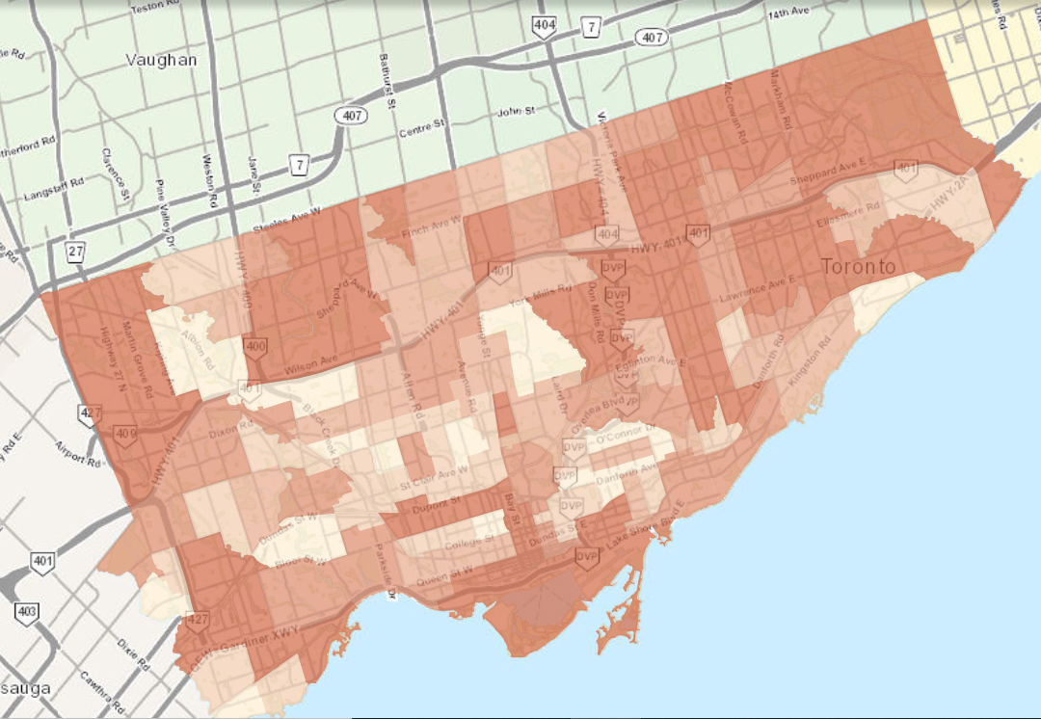
Project Description and Outline
To analyze selected 40 types of Toronto’s socioeconomic data from 2014.
Each type of socioeconomic data corresponds to each region of Toronto.
There are in total 140 regions.
To use Python to draw correlations between socioeconomic data.
With libraries Pandas and Math.
To use correlation data to suggest Toronto development strategies.

Slide 3
Project Procedures
Downloaded 41 Toronto’s socioeconomic data of choice from 2014 as .csv from Wellbeing Toronto .
Raw data
Explanation for each type of data
Normalized applicable data in Excel by dividing applicable data by population of each region to allow comparison.
Examples of such data include number of visible minority, labour force, recent immigrants, and etc.
Normalized data

Slide 4
Project Procedures
With Anaconda, opened Spyder as the IDE with Python 3.7 and pandas loaded in the environment.
Developed Python code has several functions (Python Code):
Extracts the .csv file and loaded as a pandas dataframe.
Converts all objects in the table as numbers from strings
Calculates Pearson correlation coefficients (r) between all combinations of 40 types of socioeconomic data (40 Choose 2=780 different combinations)
Partitioning the data based on r values
Strong correlation |r|>=0.7
Weak correlation 0.7>|r|>=0.5
No correlation |r| <0.5

Slide 5
Project Procedures
Plotted and analyzed the strong correlated data
Explained the correlation and proposed strategies

Slide 6
Results: Overview
My python script ran successfully. In terms correlation:
25 pairings of socioeconomic data were found to be strongly correlated
215 pairings were found to be weakly correlated
501 pairings were found to be not correlated
In the following slides I will be presenting 5 pairings:
With College Certificate/Diploma vs In Labour Force
Low Income Population vs Not a Visible Minority
Lone Parent Families vs Less than grade 9
Thefts vs Part-Time Employment
Lone Parent Families vs With Bachelor Degree or Higher

Slide 7
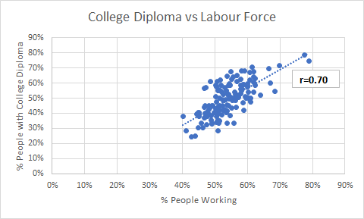
Result 1- Labour Force vs College Diploma
Strong positive correlation (r=0.7) can be observed between the % people with college diploma and % people who work.
This correlation suggests that people with jobs are the ones with college diplomas which implies the college education is rather successful at preparing graduates for job hunt. Same labour force data with bachelor’s degree or higher is only weakly correlated at r=0.64.

Slide 8
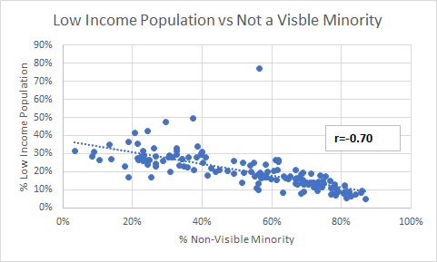
Result 2-Low Income Population vs Not a Visible Minority
Strong negative correlation (r=-0.7) can be observed.
Not a visible minority is defined as the caucasian population in that region.
This correlation suggests that regions with more caucasians have less low income population. This potentially suggests that Caucasians are not experiencing poverty.
Based on this finding, I recommend Toronto to focus more on poverty within visible minority

Slide 9
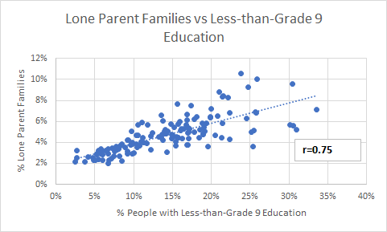
Result 3-Lone Parent Families vs Less-than-Grade 9 Education
Strong positive correlation (r=0.75) can be observed.
Lone parent families are single parent families. This correlation suggests that regions with more single parent families have more people with less-than grade 9 education.
Hard to decipher the possible causation. Whether lower-than-average years of education or having more single parents leads to another. It’s possible that there is a feedback loop
I recommend Toronto to have educational programs catered towards single-parent families such as after -school programs to assist in promoting education.

Slide 10
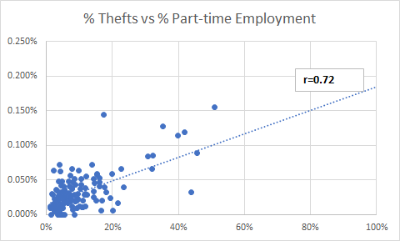
Result 4- Thefts vs Part-time Employment
Strong positive correlation (r=0.72) can be observed. Regions with more thefts per population happens to have more part-time employment rate
The correlation can be hypothesized to be that since part-time employment does not generate enough income to support the expensive life styles in Toronto, perhaps some people resort to stealing
I recommend to have more community housing, food banks, and employment centres at regions where there are more part-time employees to support them job-wise and financially to decrease the the theft rate at high part-time employment regions

Slide 11
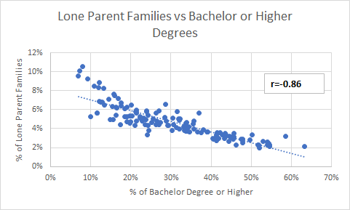
Result 5- Lone Parent Families vs Bachelor or Higher Degrees
Strong negative correlation (r=-0.86) can be observed. Regions with more bachelor degrees or higher have less single parent families per population.
The correlation can be hypothesized that having less single parents can potentially lead to higher education. This result is aligned with result 3.
I recommend Toronto to have educational programs catered towards single-parent families such as after -school programs to assist in promoting education.

